Slide 1


Sign Language Recognition System
SRM Institute of Science and Technology
College of Engineering & Technology | School of Computing
Department of Computing Technologies
18CSC305J Artificial Intelligence – Mini Project
Team Members
RA2111026010357 ANIKET SONAR

Slide 2
SOCIETAL BENEFIT
Accessibility: Enables Deaf/Hearing individuals to interact with technology and services.
Communication: Breaks down language barriers, facilitating smoother interactions.
Empowerment: Grants autonomy in expression, information access, and navigation.
Education: Integrates into educational tools, promoting cultural awareness.
Employment: Reduces barriers, enhancing job opportunities and economic empowerment.
Healthcare: Ensures clear communication for better health outcomes and satisfaction.
Legal/Civic Engagement: Improves accessibility to legal and civic services.
Research & Development: Drives innovation for accuracy and usability advancements.

Slide 3
PROBLEM STATEMENT
Statement: Sign language recognition aims to bridge communication gaps for the deaf and hard-of-hearing community by accurately interpreting sign language gestures in real-time.
Description: Sign language recognition involves developing systems that can understand and interpret sign language gestures performed by individuals.
These systems typically utilize computer vision and machine learning techniques to analyze and recognize hand movements, shapes, and positions.
The goal is to create accessible communication tools that enable seamless interaction between sign language users and non-signers, promoting inclusivity and accessibility in various domains such as education, employment, and social interactions.

Slide 4
OBJECTIVE WITH TECHNICAL DEPTH
Objective: Develop a Sign Language Recognition System (SLRS) to empower Deaf and Hard of Hearing individuals, addressing key technical challenges:
- Utilize computer vision techniques for precise gesture detection in images.
- Extract relevant features from sign language pixelated images using state-of-the-art algorithms.
- Incorporate linguistic models for context-aware interpretation of sign language.
- Implement temporal modeling to capture sequential dependencies in gestures.
- Design intuitive user interfaces and integrate with assistive technologies.
- Ensure scalability and compliance with accessibility standards.

Slide 5
LITERATURE SURVEY :-
Paper Name | Work Done/Description | Inference from the Paper
AN AMERICAN SIGN LANGUAGE DETECTION SYSTEM USING HSV COLOR MODEL AND EDGE DETECTION A. SHARMILA KONWAR; B. SAGARIKA BORAH; C. T. TUITHUNG | >Uses HSV colour model and edge detection for recognizing hand signs. >The RGB images are then converted into the HSV colour space. >Relevant features, such as area and perimeter, are extracted from the contours to train a machine learning model. | >This trained model can subsequently be applied to real-time video or image streams, providing an accurate and efficient ASL recognition system for communication purposes.
INTELLIGENT SIGN LANGUAGE RECOGNITION USING IMAGE PROCESSING SAWANT PRAMADA , DESHPANDE SAYLEE, NALE PRANITA, NERKAR SAMIKSHA, MRS.ARCHANA S. VAIDYA | >Hand region detection techniques are applied to isolate the hand from the background, followed by feature extraction. >Utilizing machine learning or pattern recognition algorithms, the system classifies the extracted features and recognizes the corresponding sign language gestures. | >Real-time recognition is achieved by continuously processing video streams or live images, enabling instantaneous interpretation. >The system translates the recognized gestures into textual or auditory output, facilitating effective communication between signers and non-signers.

Slide 6
LITERATURE SURVEY :-
Paper Name | Work Done/Description | Inference from the Paper
REAL-TIME STATIC HAND GESTURE RECOGNITION FOR AMERICAN SIGN LANGUAGE (ASL) IN COMPLEX BACKGROUND JAYASHREE R. PANSARE, SHRAVAN H. GAWANDE, MAYA INGLE | >The hand region is detected using methods like skin colour segmentation or machine learning-based approaches. >To handle complex backgrounds, sophisticated techniques such as background modeling and adaptive thresholding are utilized. | >The system can achieve accurate and real-time recognition of ASL hand gestures in diverse and complex visual environments, contributing to improved accessibility and communication for the deaf and hard of hearing community.

Slide 7
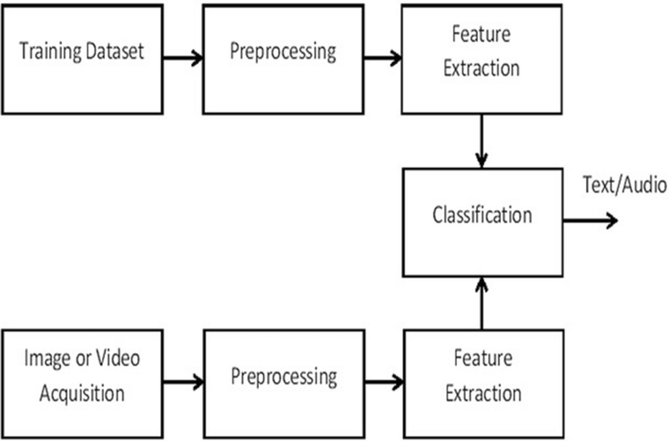
SIGN LANGUAGE SYSTEM WORKFLOW

Slide 8
PROPOSED WORKFLOW
1. Input Acquisition and Preprocessing:-
Obtain Image Input: Obtain sign language images from the web as an input for the system.
Preprocessing: Enhance image quality and remove noise through preprocessing techniques to optimize gesture recognition.
2. Hand Gesture Detection
Computer Vision Analysis: Analyze images using computer vision techniques to detect hand gestures.
Key Point Identification: Identify key points such as fingertips, palm contours, and hand orientation for accurate gesture recognition.
Algorithm Implementation: Employ advanced algorithms like convolutional neural networks (CNNs) for gesture classification.

Slide 9
PROPOSED WORKFLOW
3. Gesture Interpretation and Mapping
Linguistic Model Integration: Map recognized gestures to a linguistic model for interpretation within appropriate grammatical and semantic contexts.
Syntax and Semantics Analysis: Integrate language models trained specifically for sign language, considering syntax, semantics, and contextual cues.
4. Output Generation
Text or Speech Synthesis: Convert interpreted sign language into natural language text or synthesized speech output.
User Preference Adaptation: Provide output in the preferred format of the user, such as visual displays, text outputs, or auditory feedback.

Slide 10
PROPOSED WORKFLOW
5. Feedback Mechanisms
Error Correction and Suggestions: Incorporate feedback mechanisms to correct recognition errors and provide suggestions for alternative interpretations.
Iterative Improvement: Continuously improve the accuracy and reliability of the SLRS through iterative feedback-driven processes.
6. User Interface Delivery
Accessible Interface Design: Deliver processed output through a user-friendly interface tailored to the accessibility needs and communication preferences of the user.
Visual, Textual, or Auditory Output: Provide output in various formats, including visual displays, text outputs, or auditory feedback.

Slide 11
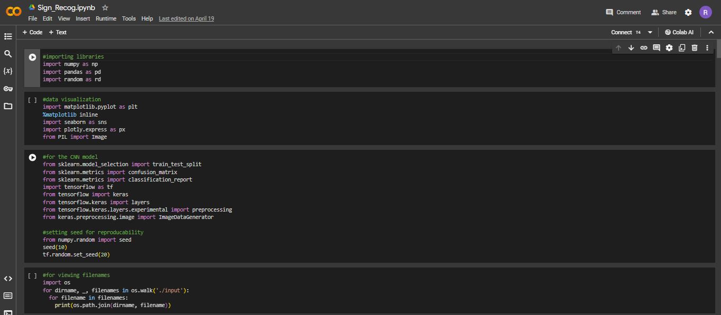
IMPLEMENTATION
CODE:-

Slide 12
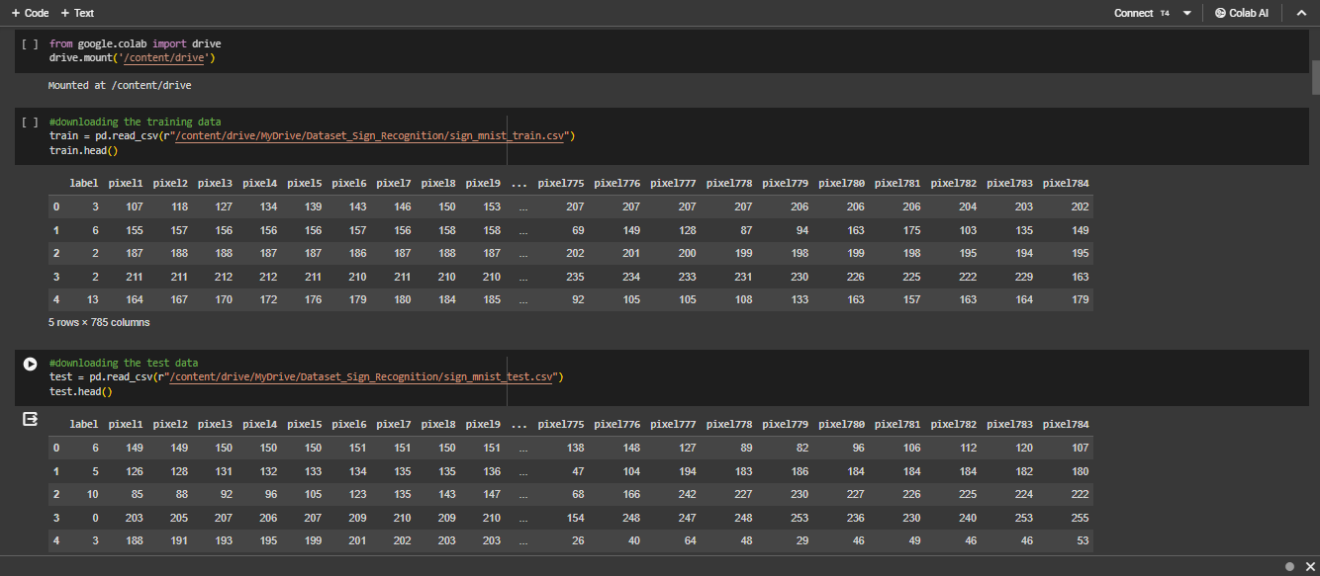
IMPLEMENTATION
CODE:-

Slide 13
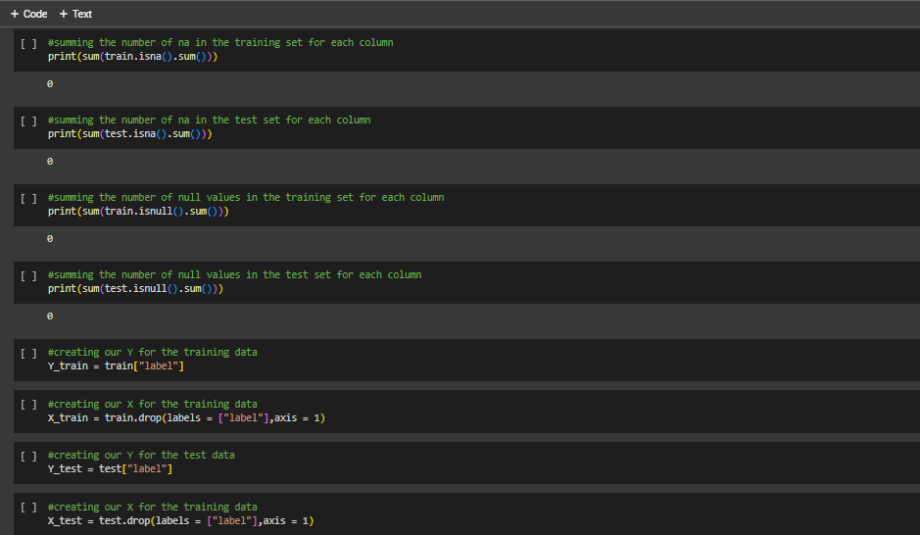
IMPLEMENTATION
CODE:-

Slide 14
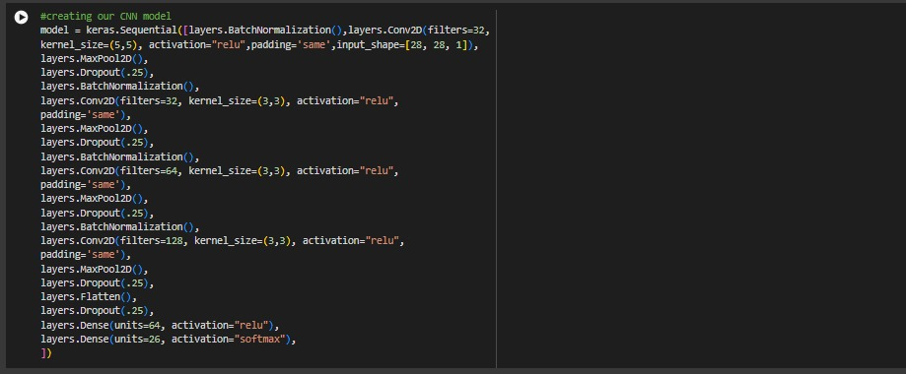
IMPLEMENTATION
CODE:-

Slide 15
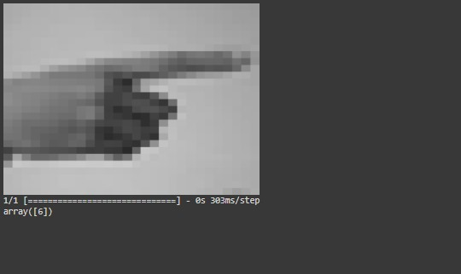
PREVIEW
OUTPUT:-

Slide 16
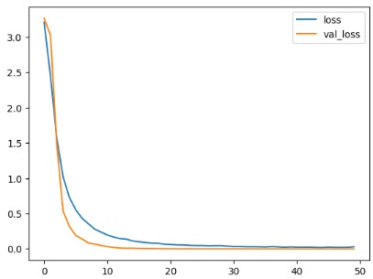
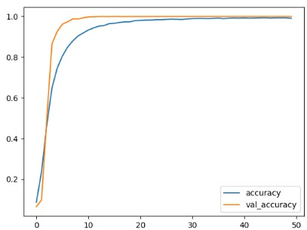
ACCURACY:-

Slide 17
ACCURACY:-

